Slide 1

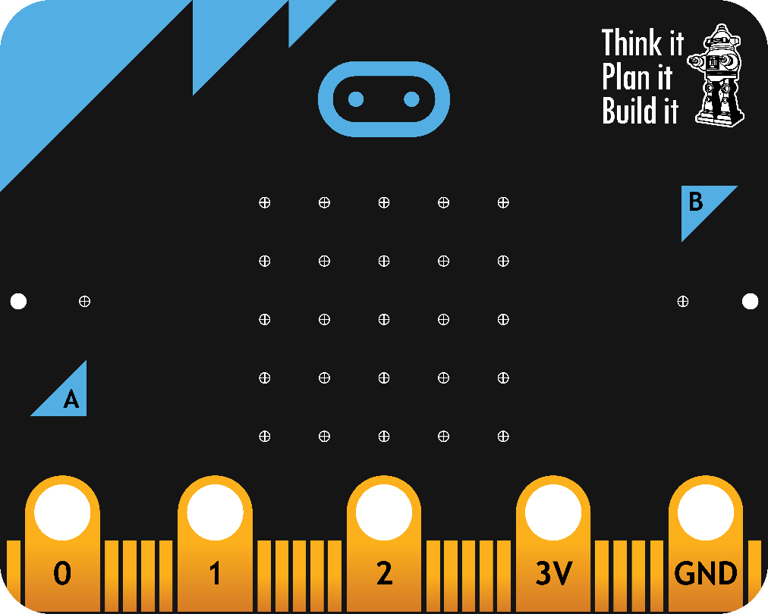

CardboardTronics and Soft Robotics with the Microbit
Pravin Vaz
Outreach Coordinator,
Engineering and Computer Science

Slide 2
Outcomes
Make simple cardboard electronics by salvaging material
Understand basic principles of Circuits
Make the Microbit work with electronics
Test out an AI/ML platform for soft robotics using the Microbit

Slide 3
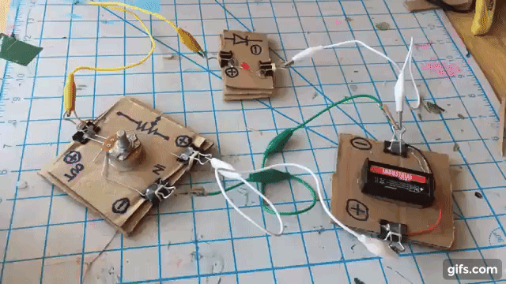
https://microsoft.github.io/cardboard-circuits/

Slide 4
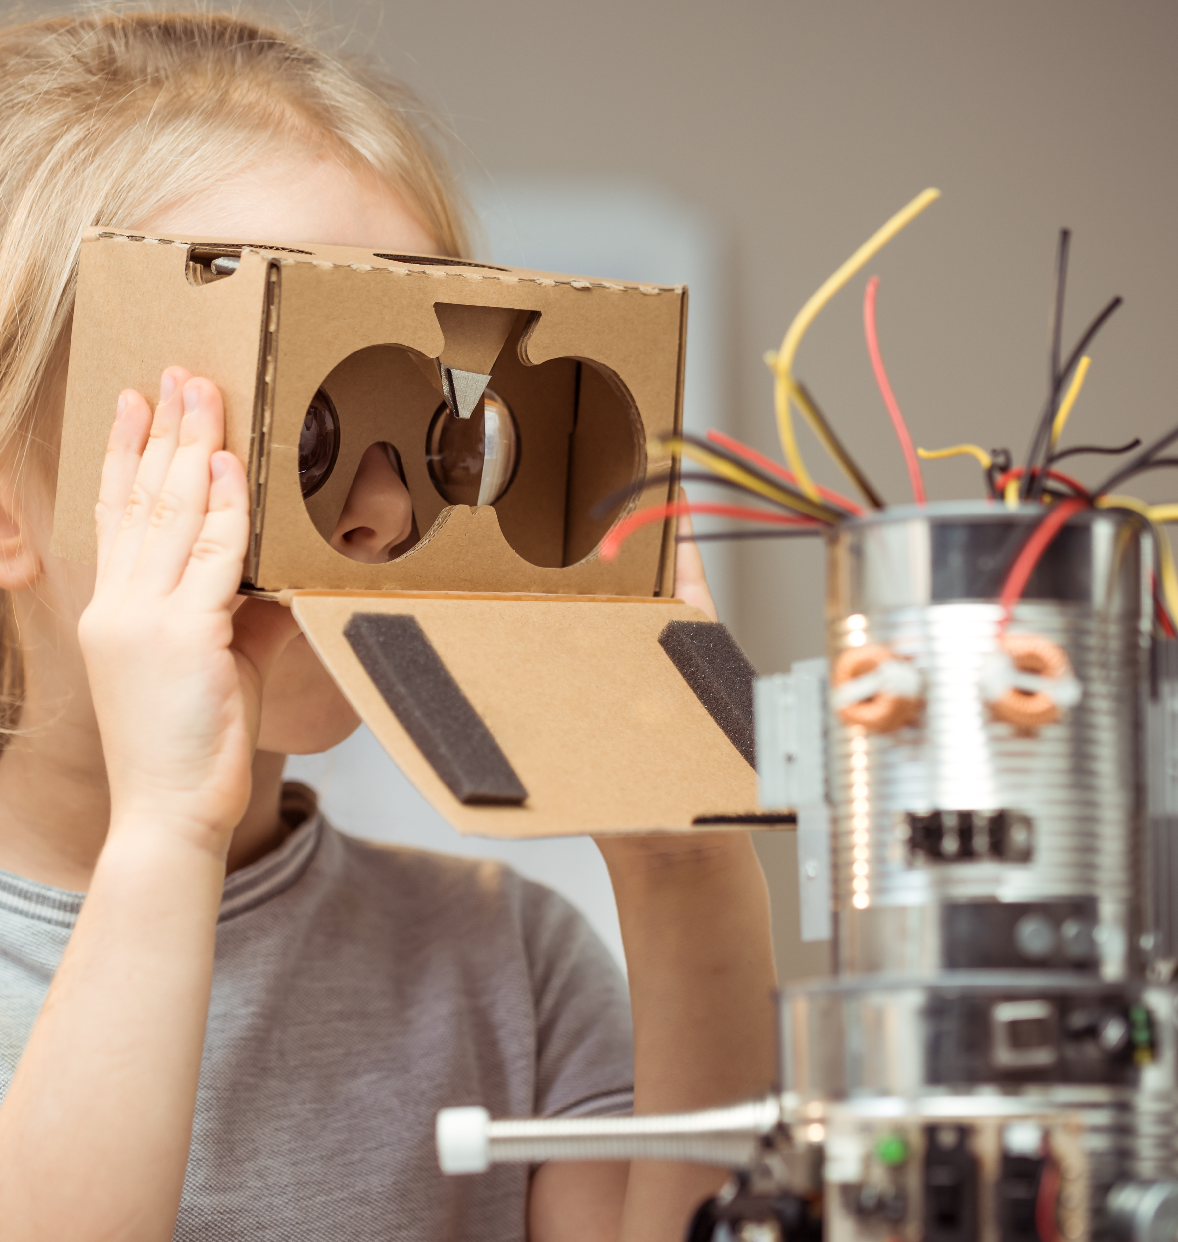
Interest
Microbit (Coding/Physical Computing)
Electronics / Circuit making / Science
Recycling / Sustainability
Engagement

Slide 5

My Journey

Slide 6
"People want everything to be a lot more repairable than it is now"
–Ugo Vallauri, The Restart Project
(Taken from IEEE Spectrum Sept. 2021)

Slide 7
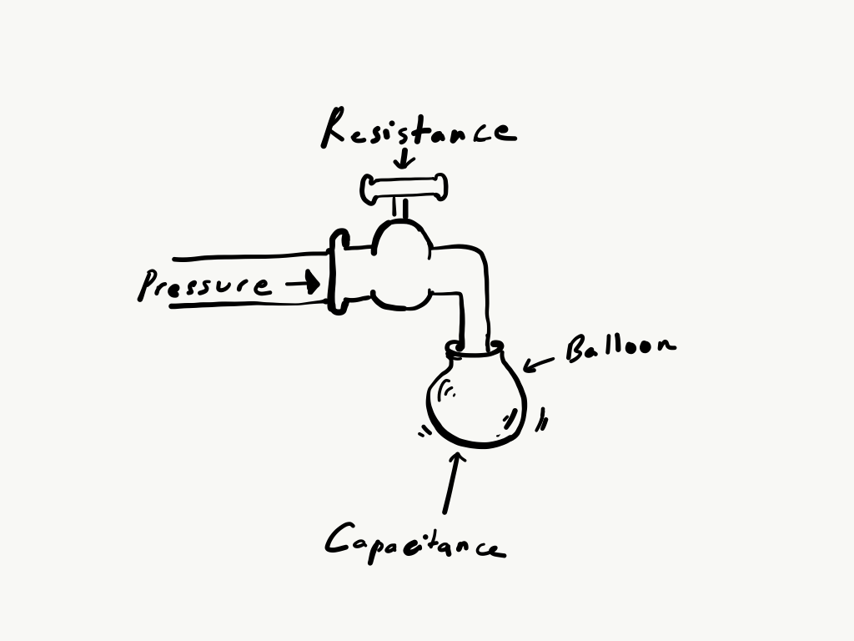
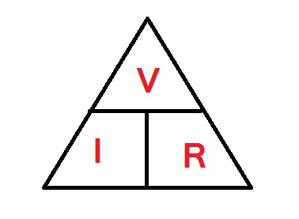
Vital to any circuit

Slide 8
Minimal electronics
Input
Power source
Wire
Control
Switch
Output
LED
Motor
Potentiometer

Slide 9
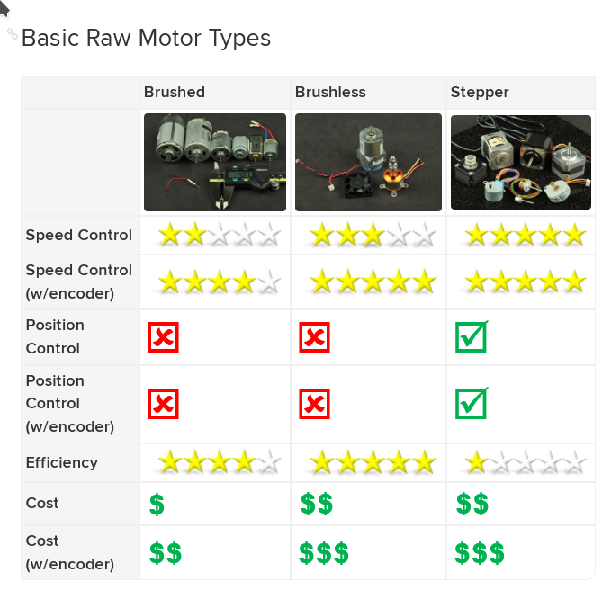
Motor types
https://learn.adafruit.com/adafruit-motor-selection-guide

Slide 10
Stripping components
Identify
What is it?
Condition
Ease of removal
Desoldering vs Unplugging
Chopping
Safety
No mains, no large capacitors

Slide 11
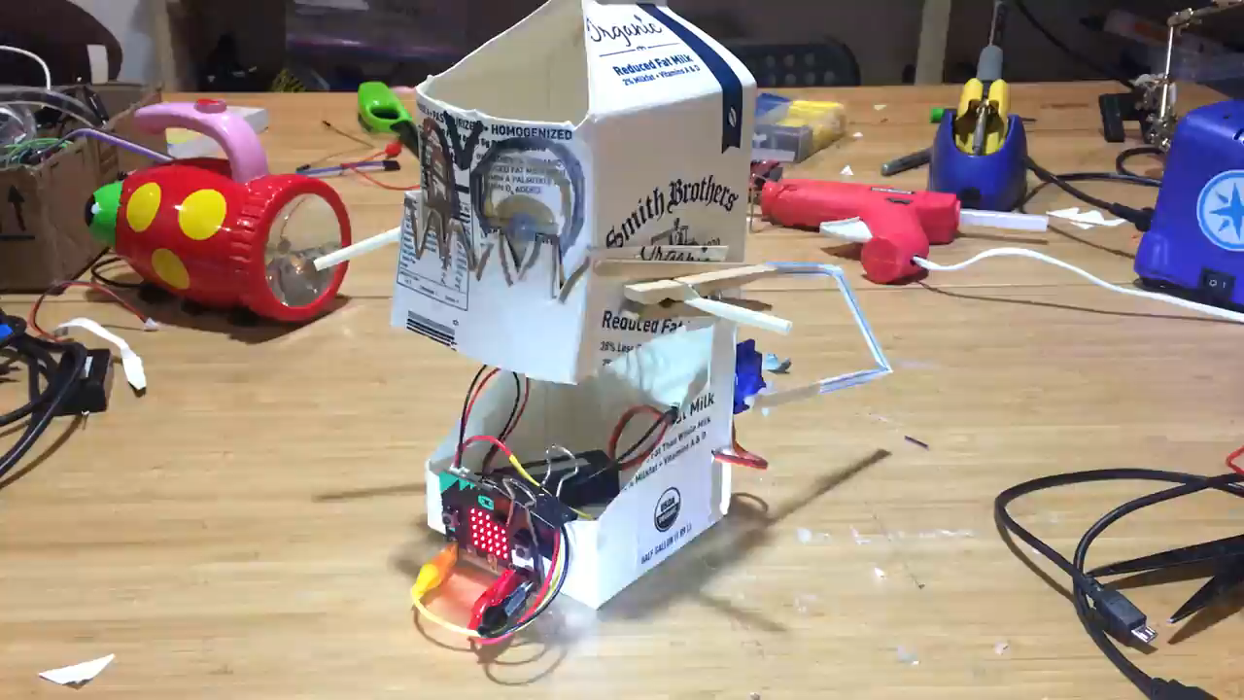
When I see an empty container, I see...
Microsoft Makecode

Slide 12
Let's get making

Slide 13
Resources
Cecilia Hillway’s lip syncing characters : https://learn.birdbraintechnologies.com/hummingbirdbit/projects/lip-synching-characters/
Captain Credible: https://www.youtube.com/watch?v=hv1QC-EiDy0
205 Microbit Projects: https://www.hackster.io/microbit/projects
Magic making with Electronics (Arduino): https://www.makershed.com/products/the-maker-magicians-handbook
Pluspal (AI/ML + Microbit): https://www.plushpal.app/
How-To Guides (Numerous projects): https://learn.browndoggadgets.com/c/MicroBit_Projects

Slide 14
More Resources
Online learning for Makecode: http://makecode.microbit.org/online-learning
Microbit PD courses: http://microbit.thinkific.com/

